Slide 1
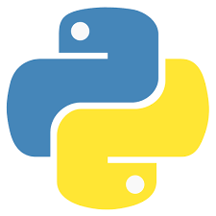
Python
by:
Dr. Muhammad Aqib
University Institute of Information Technology
PMAS-Arid Agriculture University Rawalpindi

Slide 2
Contents
What is python?
How to install python?
Verify your python installation
What is Anaconda?
How to Install Anaconda?
Why do we need Anaconda?
Verify your Anaconda installation
Lets Start by Printing with Python
How to Reach Me?

Slide 3
What is Python?
A popular, 30-year-old general purpose programming language.
Created by Guido van Rossum.
Reasonably easy to learn, and relatively easy to read.
Often used to teach beginners the fundamentals of programming.

Slide 4
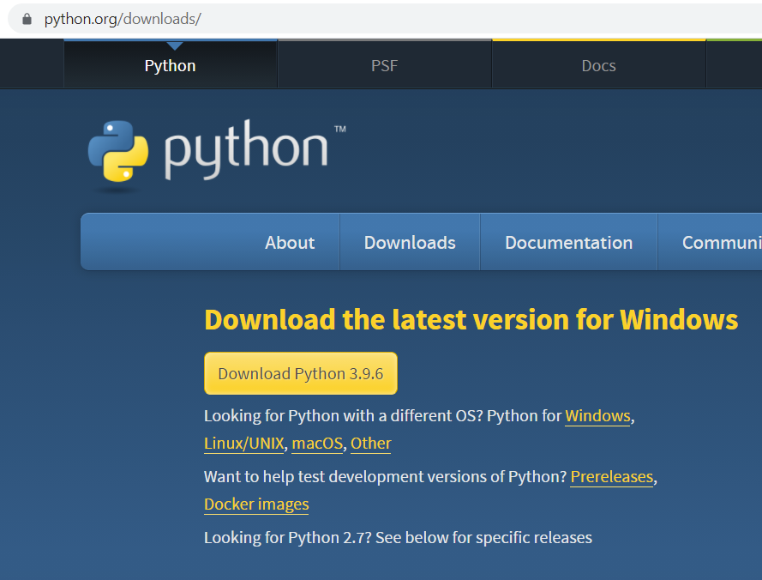
How to Install python?
STEP 1: Open the link https://www.python.org/downloads/

Slide 5
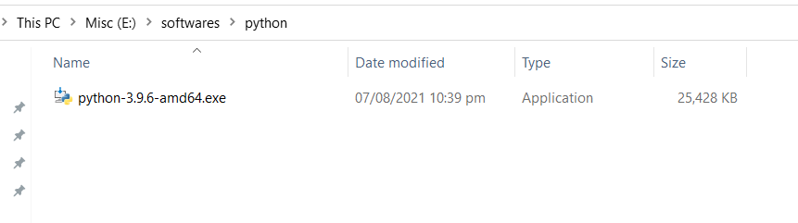
How to Install python? (cont.)
STEP 2: Open File Explorer and double-click the file downloaded.

Slide 6
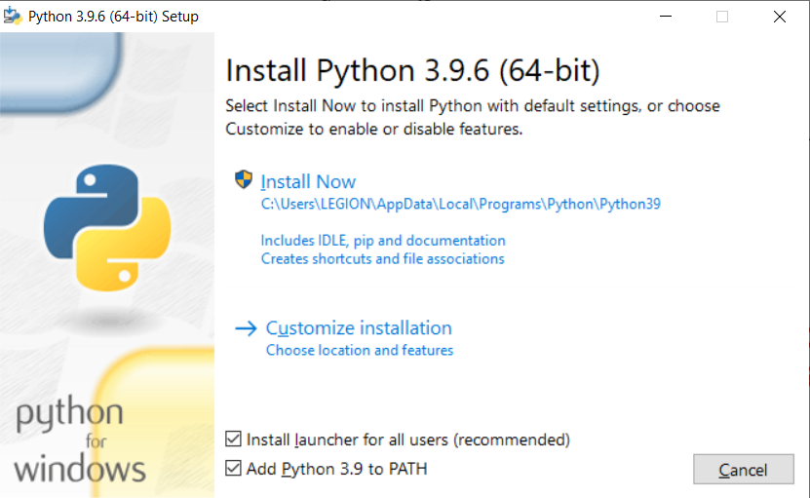
How to Install python? (cont.)
STEP 3: Check the box for making it available for all users and also to set the PATH.

Slide 7
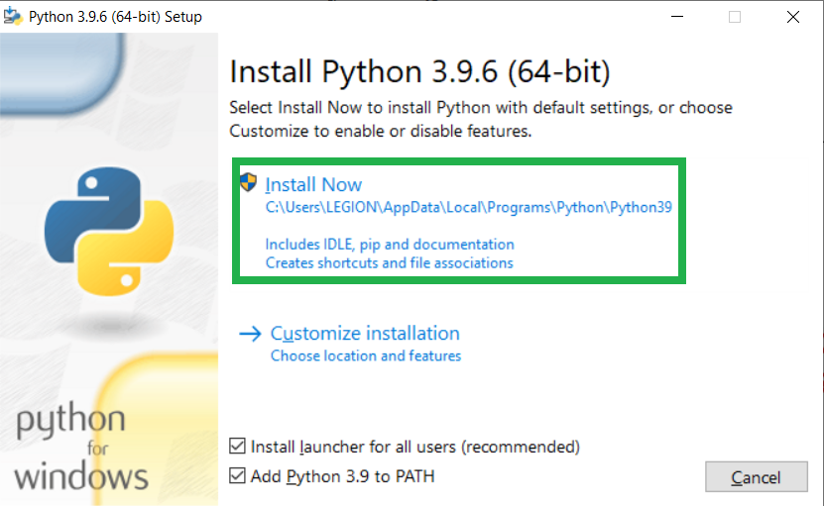
How to Install python? (cont.)
STEP 4: Click ”Install Now” to start Installation of specified version.

Slide 8
How to Install python? (cont.)
STEP 5: If a message asks, "Do you want to allow this app to make changes to your device?" click Yes

Slide 9
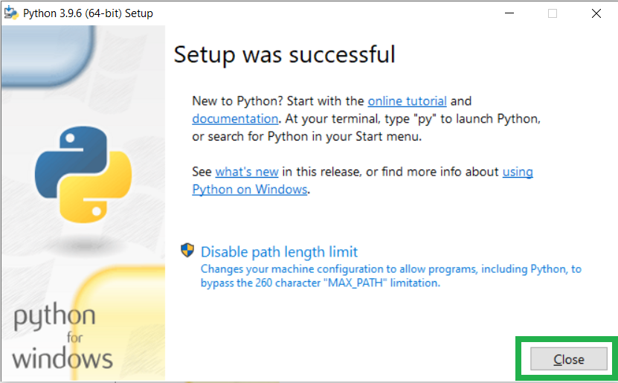
How to Install python? (cont.)
Installation Completed..

Slide 10
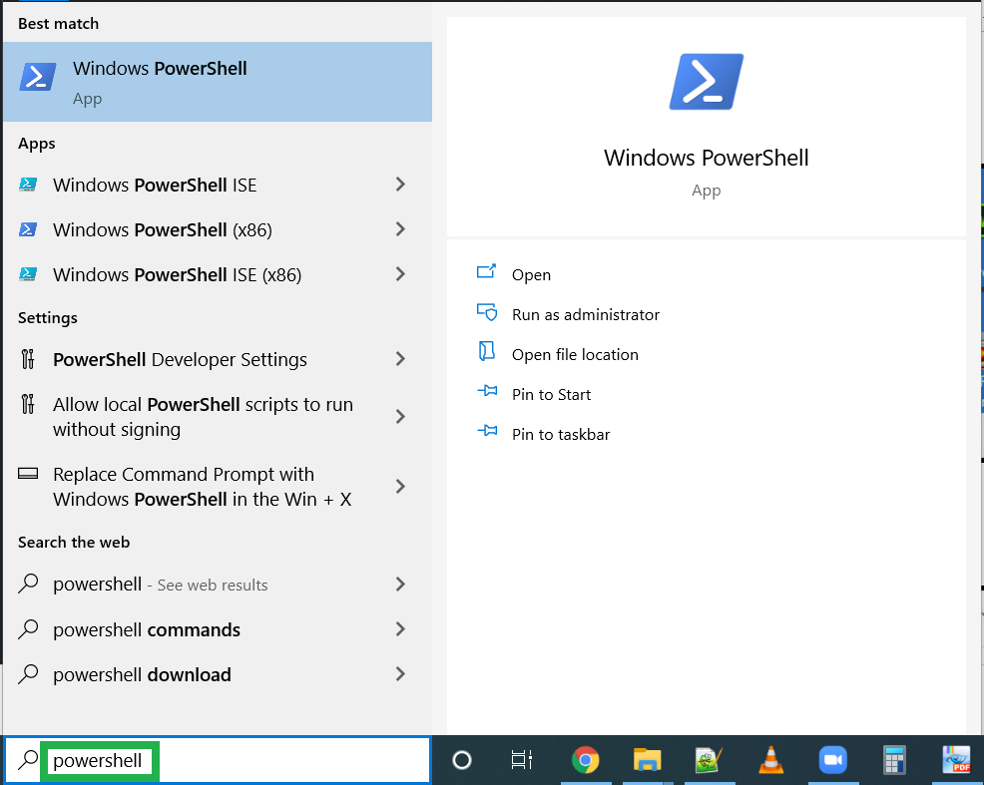
Verify Your Python Installation
Write PowerShell in Windows search bar

Slide 11
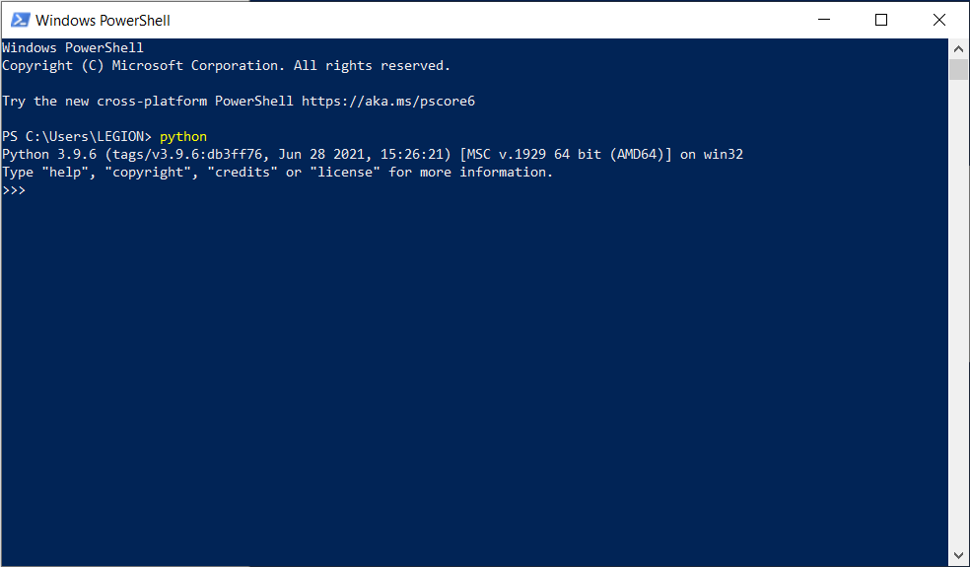
Verify Your Python Installation (cont.)
Write “python” in Windows PowerShell.

Slide 12
Verify Your Python Installation (cont.)
If Python is installed correctly, information about the Python version that you installed displays.

Slide 13
Verify Your Python Installation (cont.)
Congratulations!!
You have successfully installed Python on your computer

Slide 14
What is Anaconda?
Anaconda is the distribution of python and R Programming Language.
Aims to simplify package management and deployment.
Anaconda is free and easy to install, and it offers free community support.

Slide 15
Why Do We Need Anaconda?
Anaconda brings many of the tools used in data science and machine learning.
It's great for having short and simple setup.
Anaconda uses the concept of creating environments so as to isolate different libraries and versions.

Slide 16
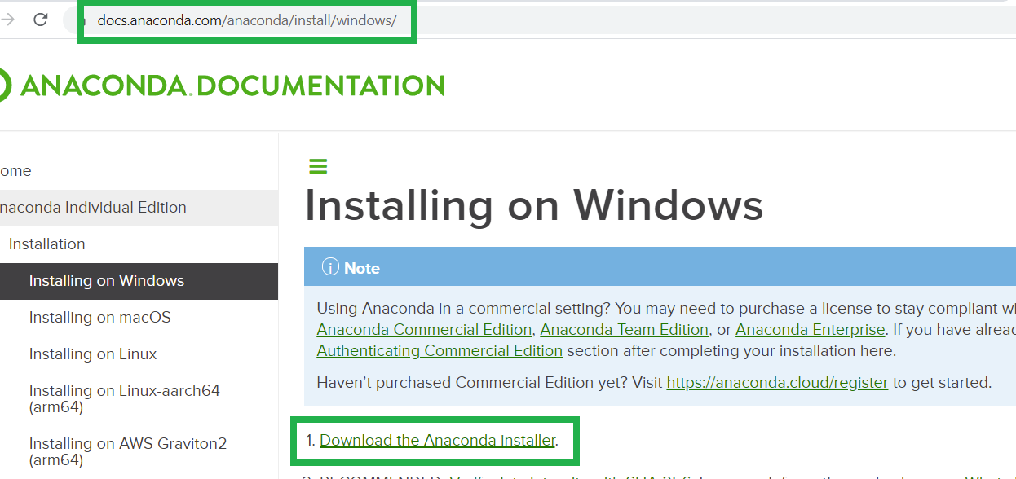
How to Install Anaconda?
Step 1: Visit Anaconda’s official page to download the installer . https://anaconda.org/anaconda/python

Slide 17
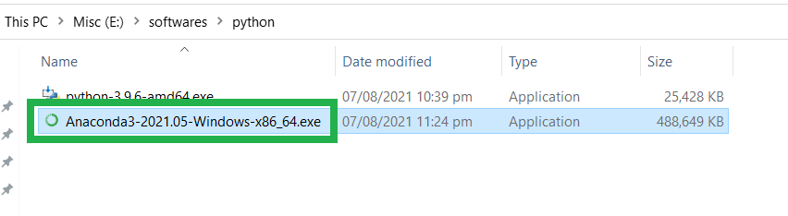
How to Install Anaconda? (cont.)
Step 2: Select the downloaded Anaconda installation file and double-click the file to launch the installer program.

Slide 18
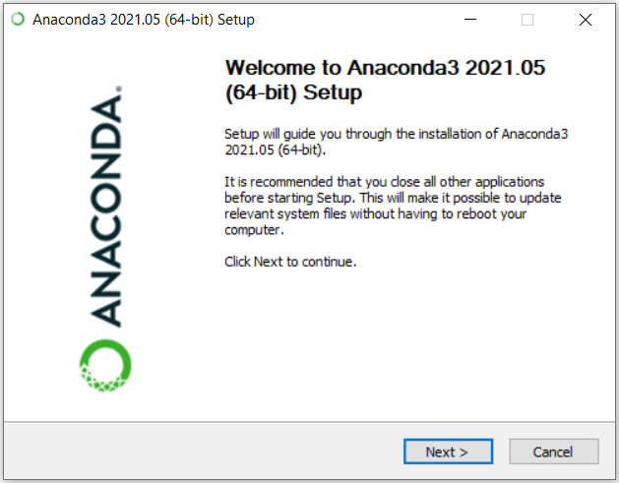
How to Install Anaconda? (cont.)
Step 3: Click Next to continue installation.

Slide 19
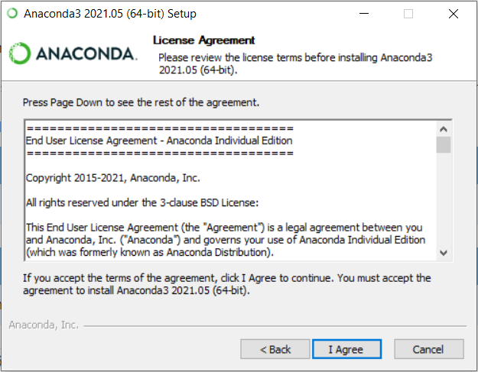
How to Install Anaconda? (cont.)
Step 4: Agree to their license agreement by clicking “I Agree” and continue the installation process.

Slide 20
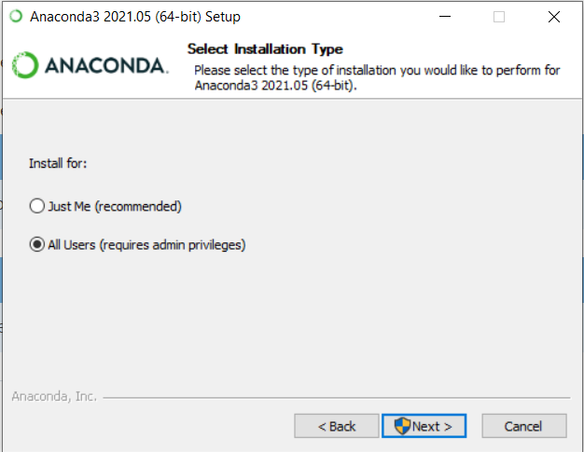
How to Install Anaconda? (cont.)
Step 5: If you want to use it for yourself only click on Just Me else select All Users

Slide 21
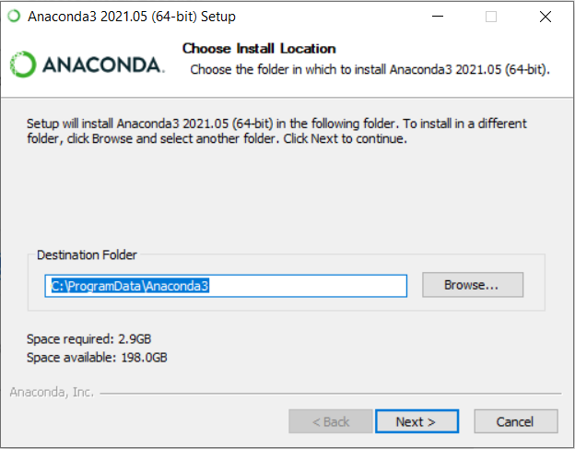
How to Install Anaconda? (cont.)
Step 6: Choose the destination folder to install Anaconda.

Slide 22
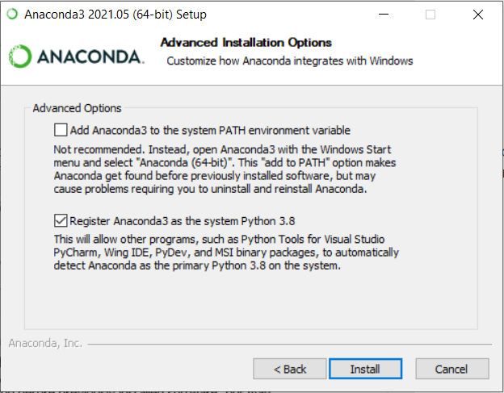
How to Install Anaconda? (cont.)
Step 7: Select the appropriate options.

Slide 23
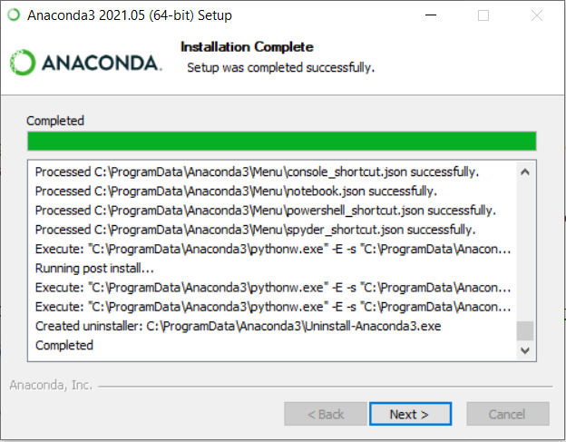
How to Install Anaconda? (cont.)
Almost done. Keep going by clicking Next.

Slide 24
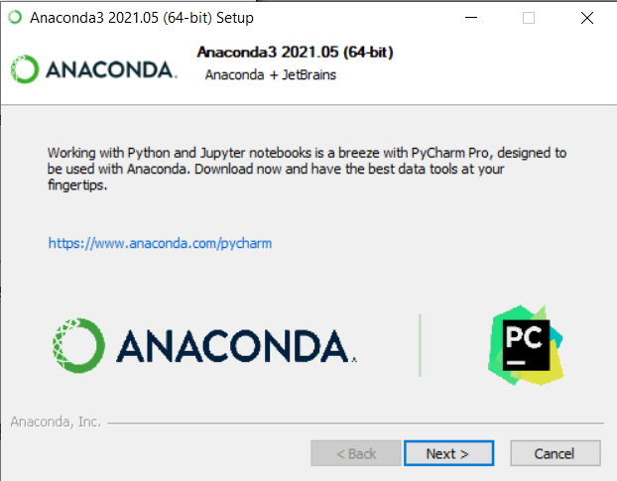
How to Install Anaconda? (cont.)
Options to install PyCharm IDE

Slide 25

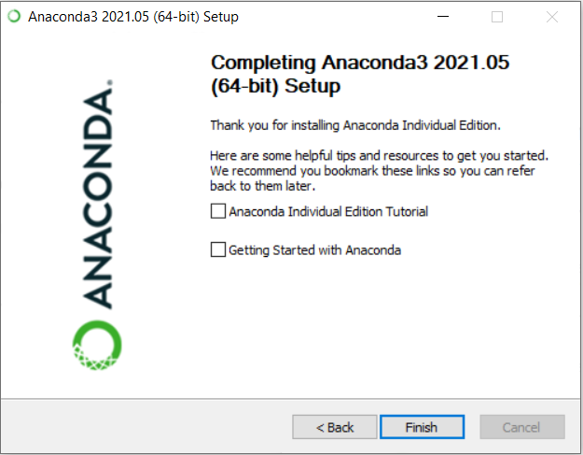
How to Install Anaconda? (cont.)
You are done!!

Slide 26
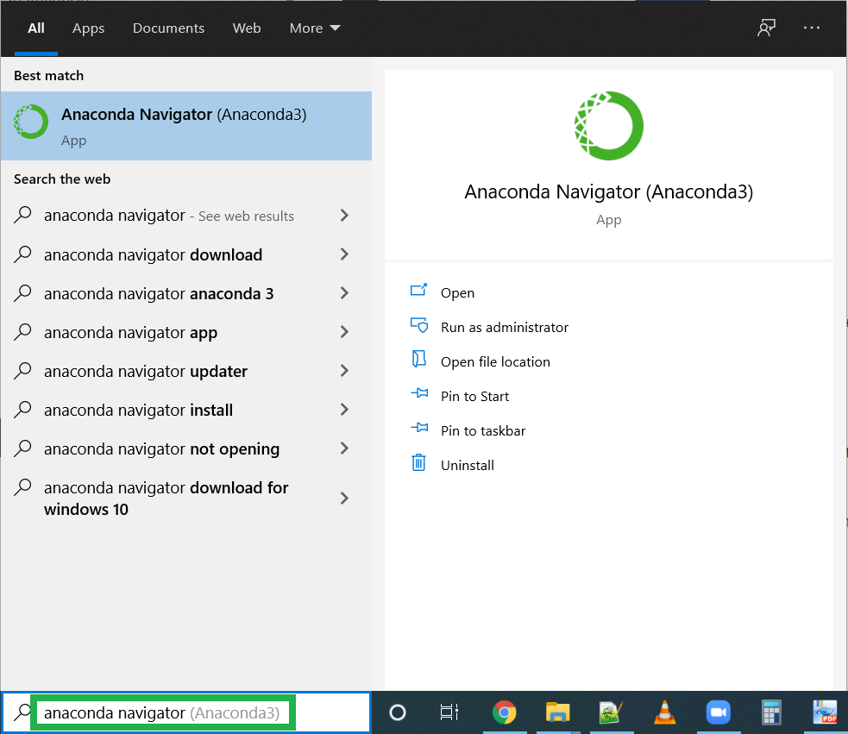
Verify Your Anaconda Installation
Write “Anaconda Navigator” in Windows search bar.

Slide 27
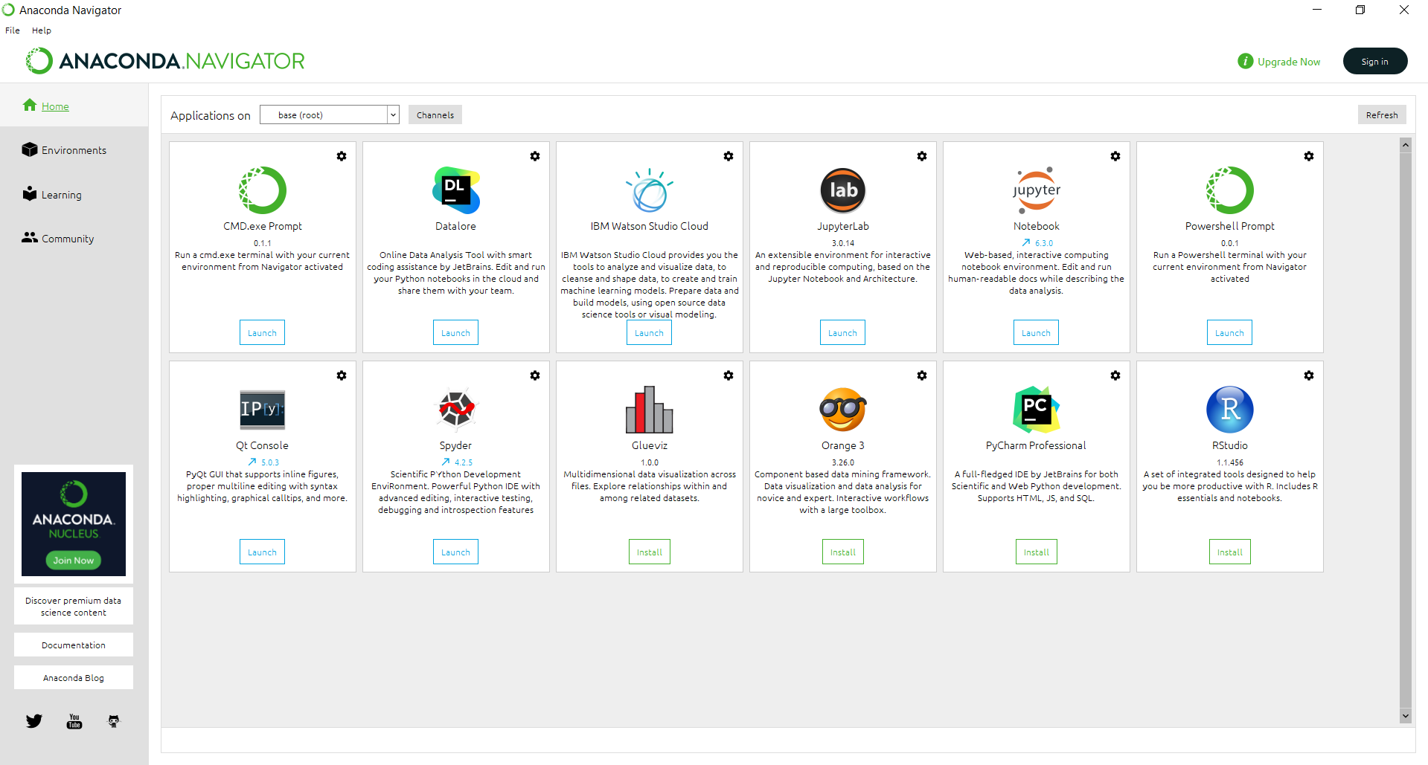
Verify Your Anaconda Installation (cont.)
Install the PyCharm IDE or you can also install any other tool as per your requirements.

Slide 28
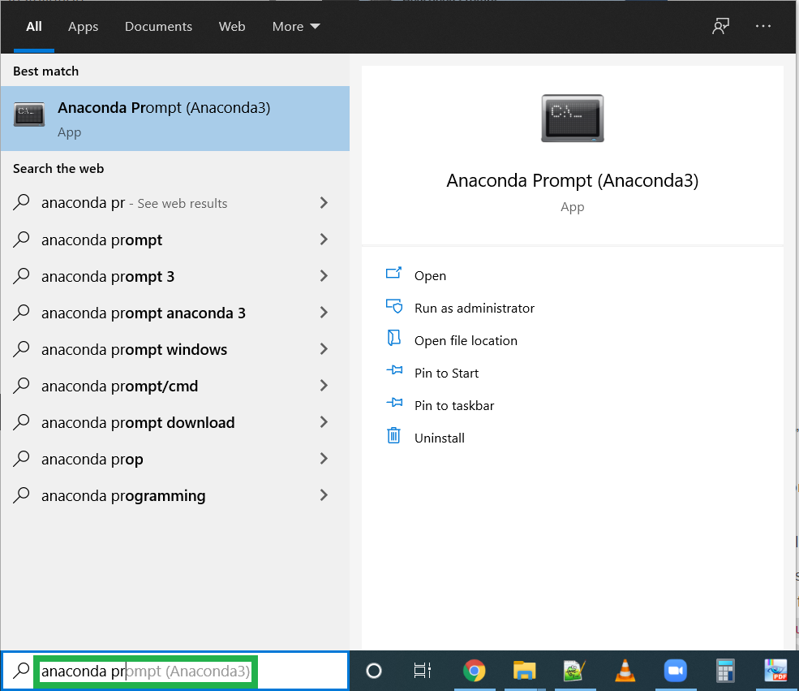
Verify Your Anaconda Installation (cont.)
Write “Anaconda Prompt” in Windows search bar.

Slide 29
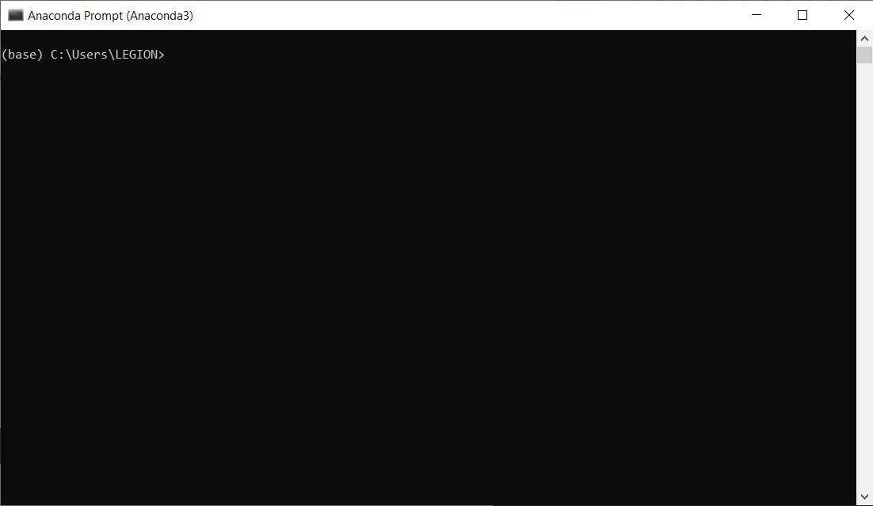
Verify Your Anaconda Installation (cont.)
A terminal will be opened if Anaconda is correctly installed on your computer.

Slide 30
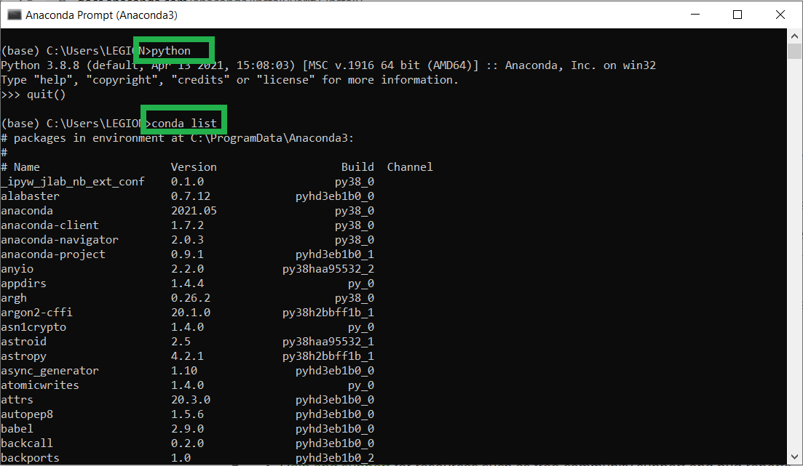
Verify Your Anaconda Installation (cont.)
Write python on opened terminal window.

Slide 31
Lets Start by Printing with Python
Command print tells the program to display words or numbers on the screen.
Print(“Thanks to Allah, we have successfully finished installation”)
print is a keyword
A word that has special meaning for Python.
It means, "Display what’s inside the parentheses."
Python is case sensitive. i.e. print cannot be capitalized.

Slide 32
How to Reach Me?
Dr. Muhammad Aqib
Assistant Professor (Computer Science)
HEC Approved Supervisor
Room 6, UIIT, PMAS-AAUR
aqib.qazi@uaar.edu.pk
0333 096 0555

Slide 33
Thank You

